Slide 1
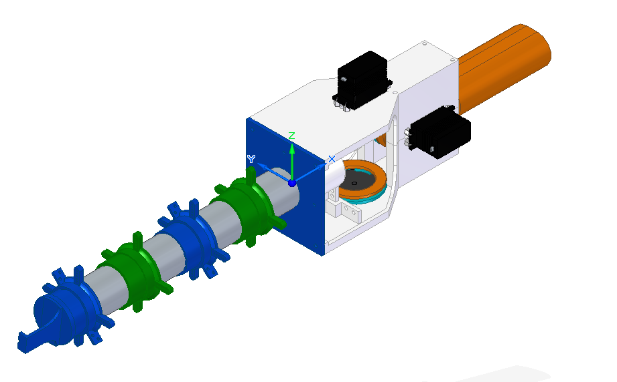


Slide 2
1
Starting Point
Z = 5
X = -30
Y = 1

Slide 3
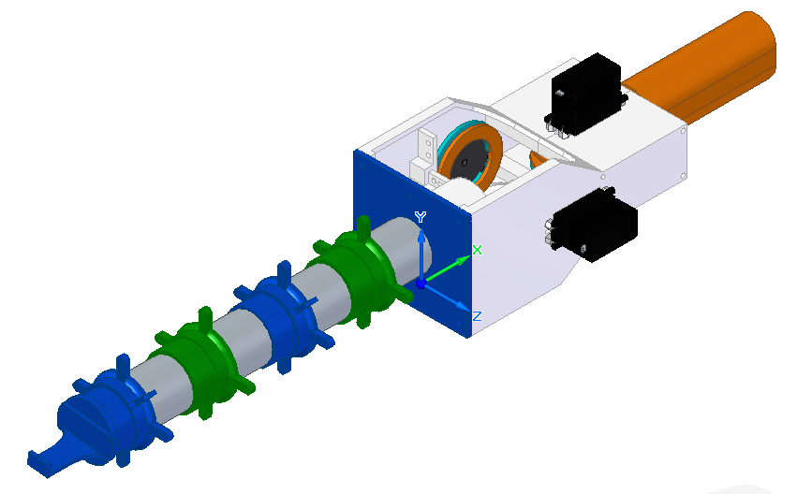
90 º about robot X axis from start
2
Y= 5
X = -30
Z = -1

Slide 4
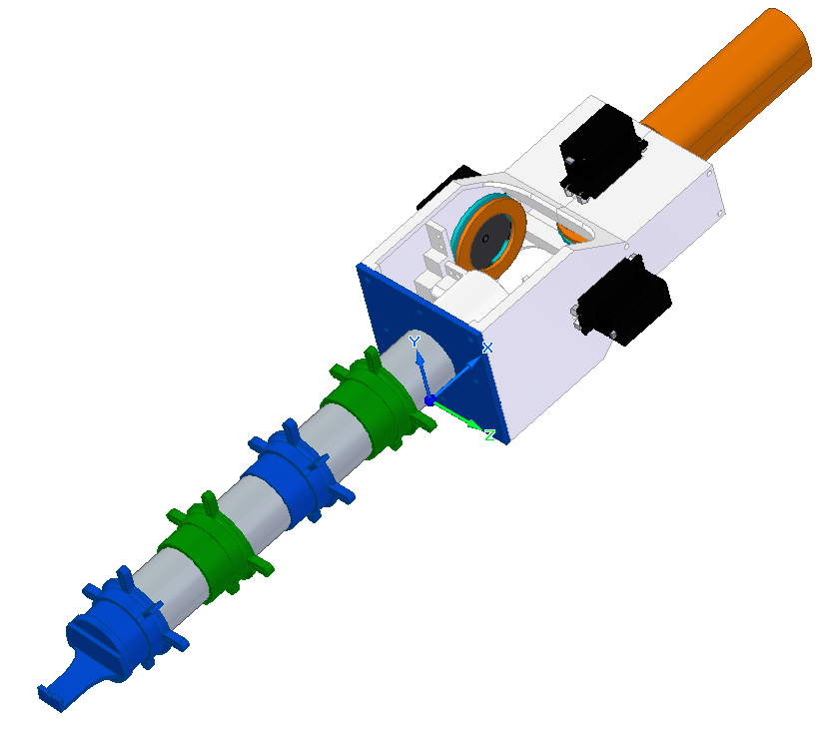
90 º about X axis and -15 º about Y axis from start
3
Y= 12.6
X = -27.7
Z = -1

